Slide 1

AI DRIVEN ADJUSTMENT OF PUBLIC IMAGES/VIDEOS FOR COMPLIANCE TO GENERAL DATA PROTECTION REGULATION (GDPR)
December 22, 2022

Slide 2
Group Members
Dharmesh Patel
Jemty Jose
Muhammad Suleman
Muhammad Azhar Mehboob

Slide 3
Table of Content
Overview
Flow Process
Performance Tuning
Application
Timeline
Reference

Slide 4
Overview
The aim of the project is to protect the privacy of an individual abiding by the GDPR.
This is implemented with the help of an AI model.
In this presentation, we will be briefly going through the process flow and results of the project.

Slide 5
Flow Process
Dataset Preparation
Model Training
Object Detection
Object Blur

Slide 6
Dataset Preparation
Necessary images were collected from open source websites like Kaggle [1] and using the webcam.
Labelling (Person, Vehicle Reg. No, Legal Documents) was done with the help of Makesense.ai and Roboflow.
3199 out of around 5000 downloaded images were used for this project .

Slide 7
Model Training
The dataset was divided into train and test sets (~80/20).
Three different training models were used to train for object detection.
SSD MobileNet 320x320
Training steps : 20k
Yolo V5
Yolo V7
100 epochs were used for training both Yolo V5 and Yolo V7

Slide 8
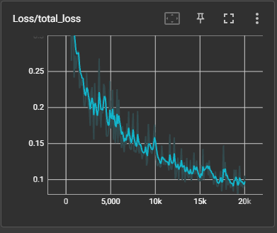
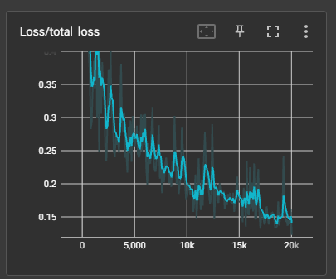
Model Training SSD MobileNet 320x320
 | Precision | Recall | Loss
Face Detection | 0.65-0.806 | 0.826 | <0.1
Vehicle Reg. No | 0.476-0.79 | 0.7 | ~0.18
Legal - Documents | 0.4 - 0.6 | 0.5 | ~.3
Face Detection
Vehicle Registration

Slide 9
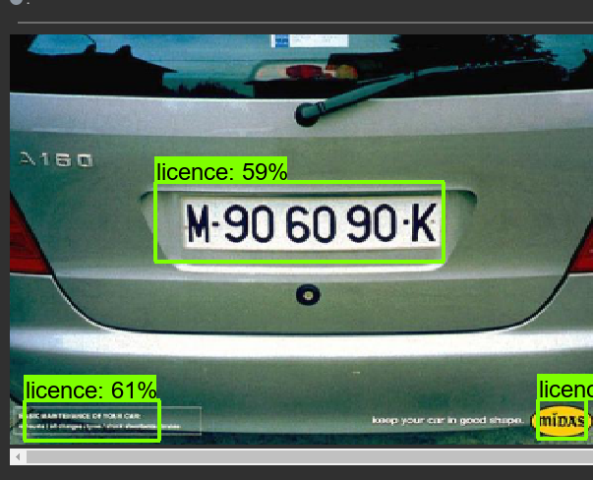
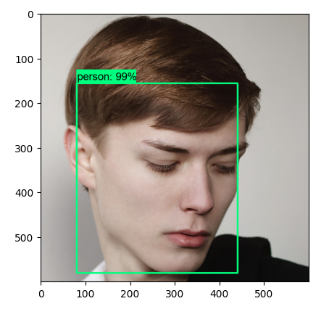
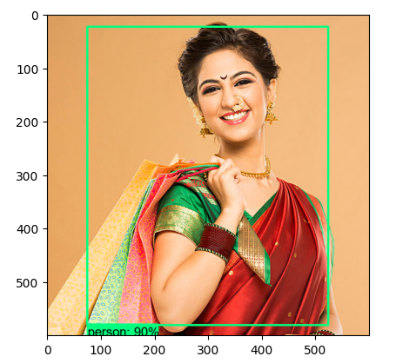
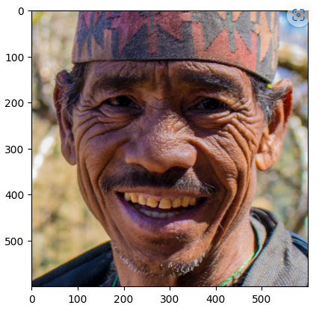
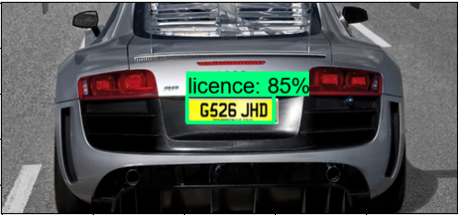
Object Detection

Slide 10
Yolo V5
It is an object detection model developed by Ultralytics in 2020.
The training model uses a 640x640 pixel resolution.
100 epochs were used to train the model.
Time taken : approx. 6 hrs on Nvidia RTX 3060 GPU

Slide 11
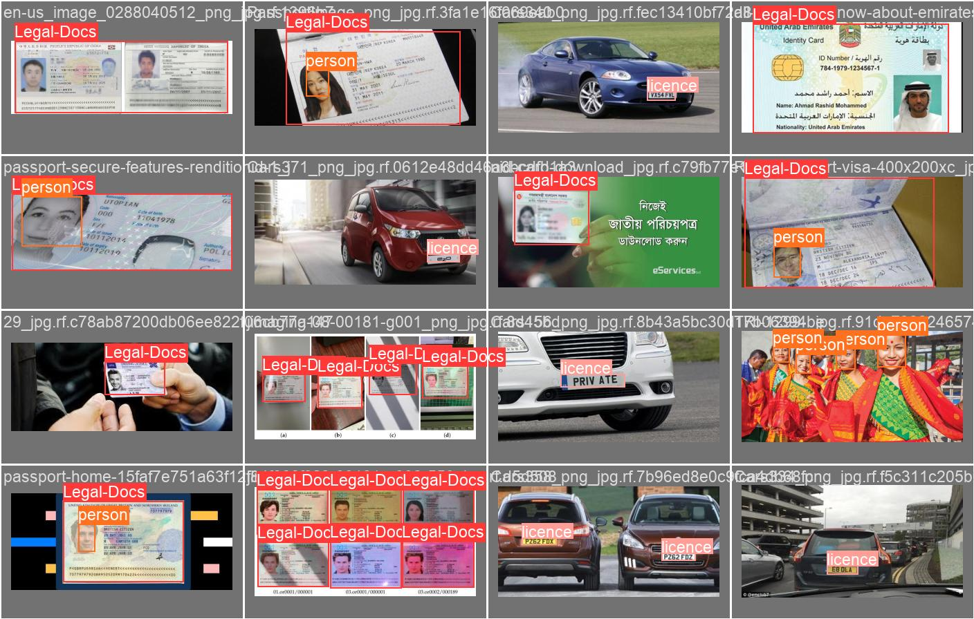
Yolo V5 Detection

Slide 12
Yolo V7
Object detection model developed by WongKinYiu and Alexey Bochkovskiy
The YOLOv7 provides more speed and accuracy compared to its previous versions.
Was released in 2022.
In this project 100 epochs were used to train the model.
Time taken : approx. 9 hrs on Nvidia RTX 3050 GPU.

Slide 13
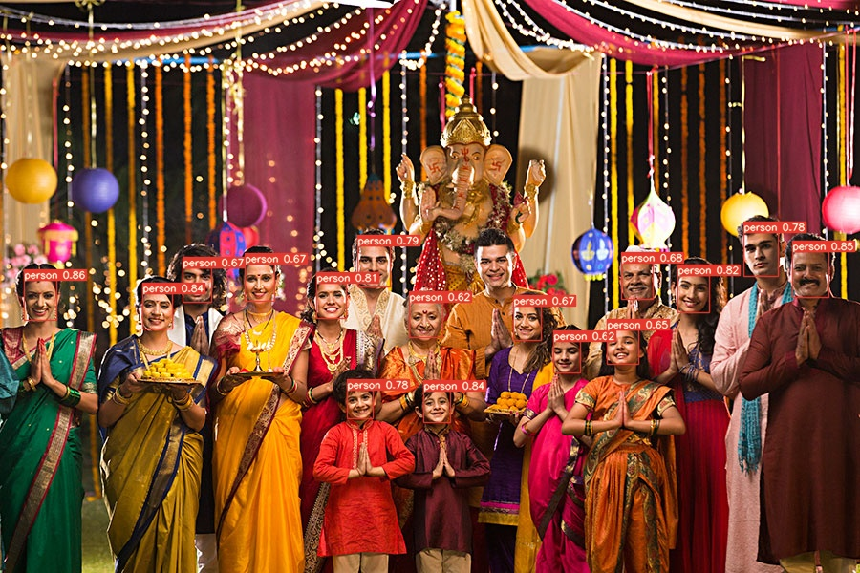
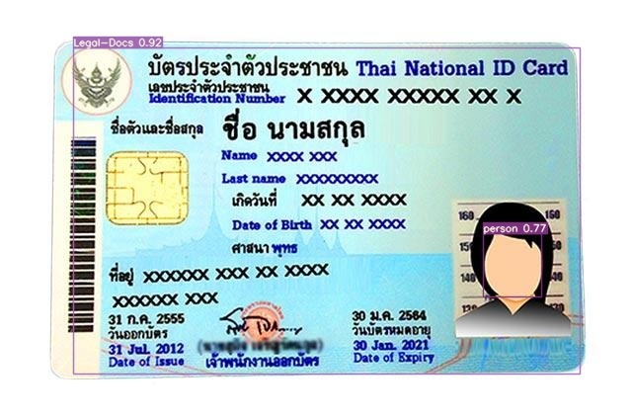
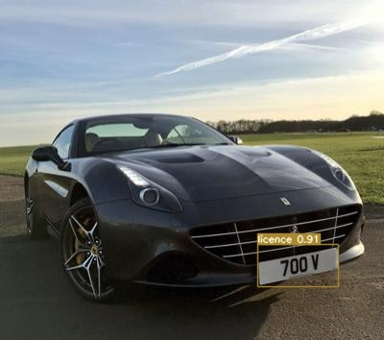
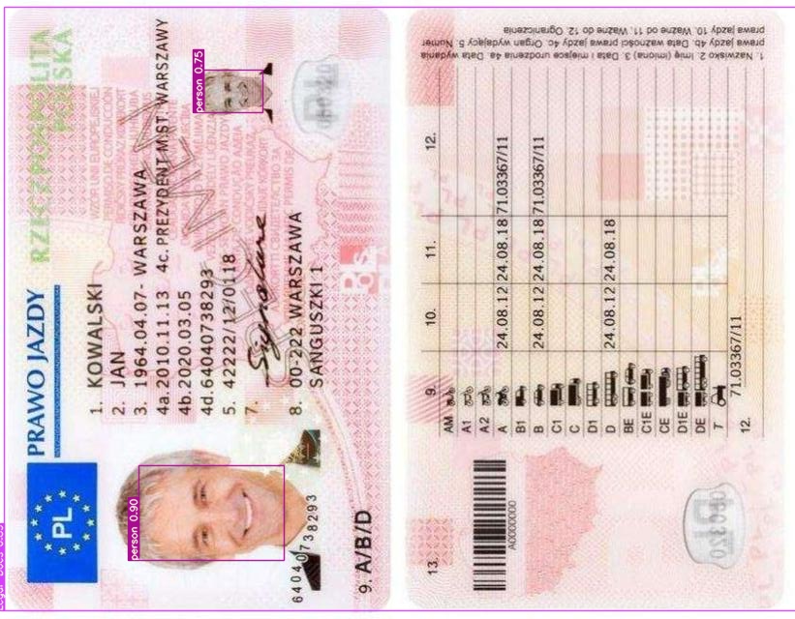
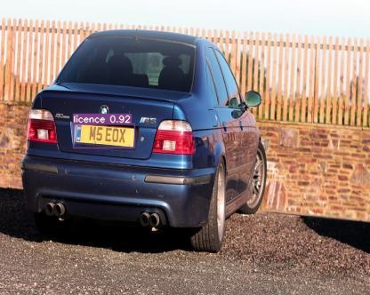
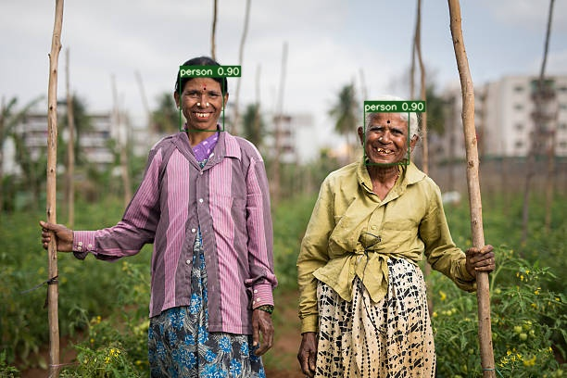
Yolo V7 Detection

Slide 14
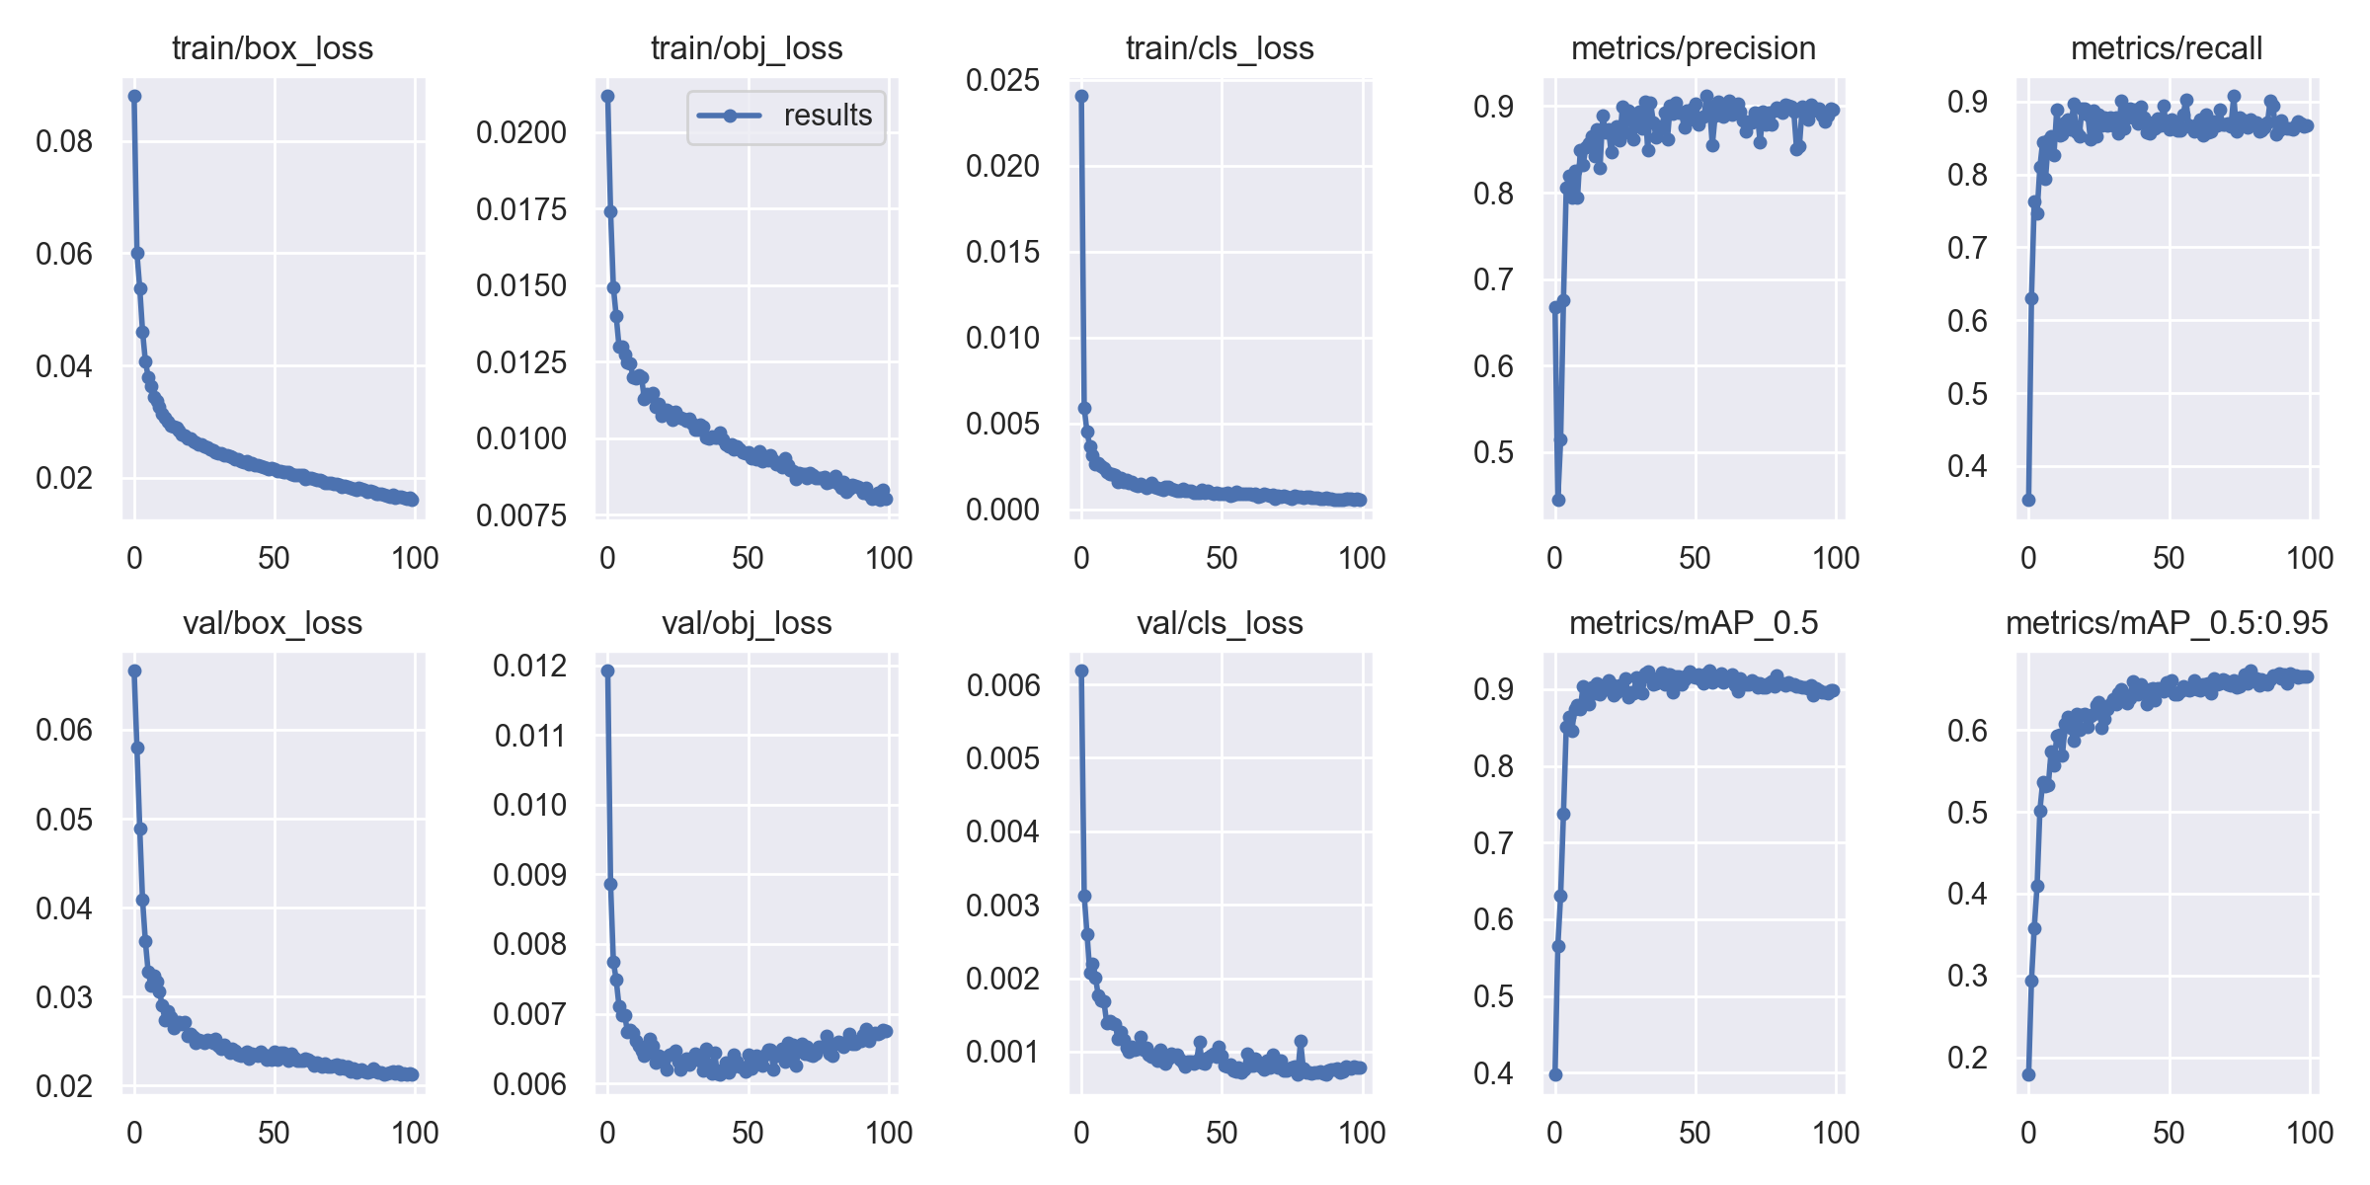
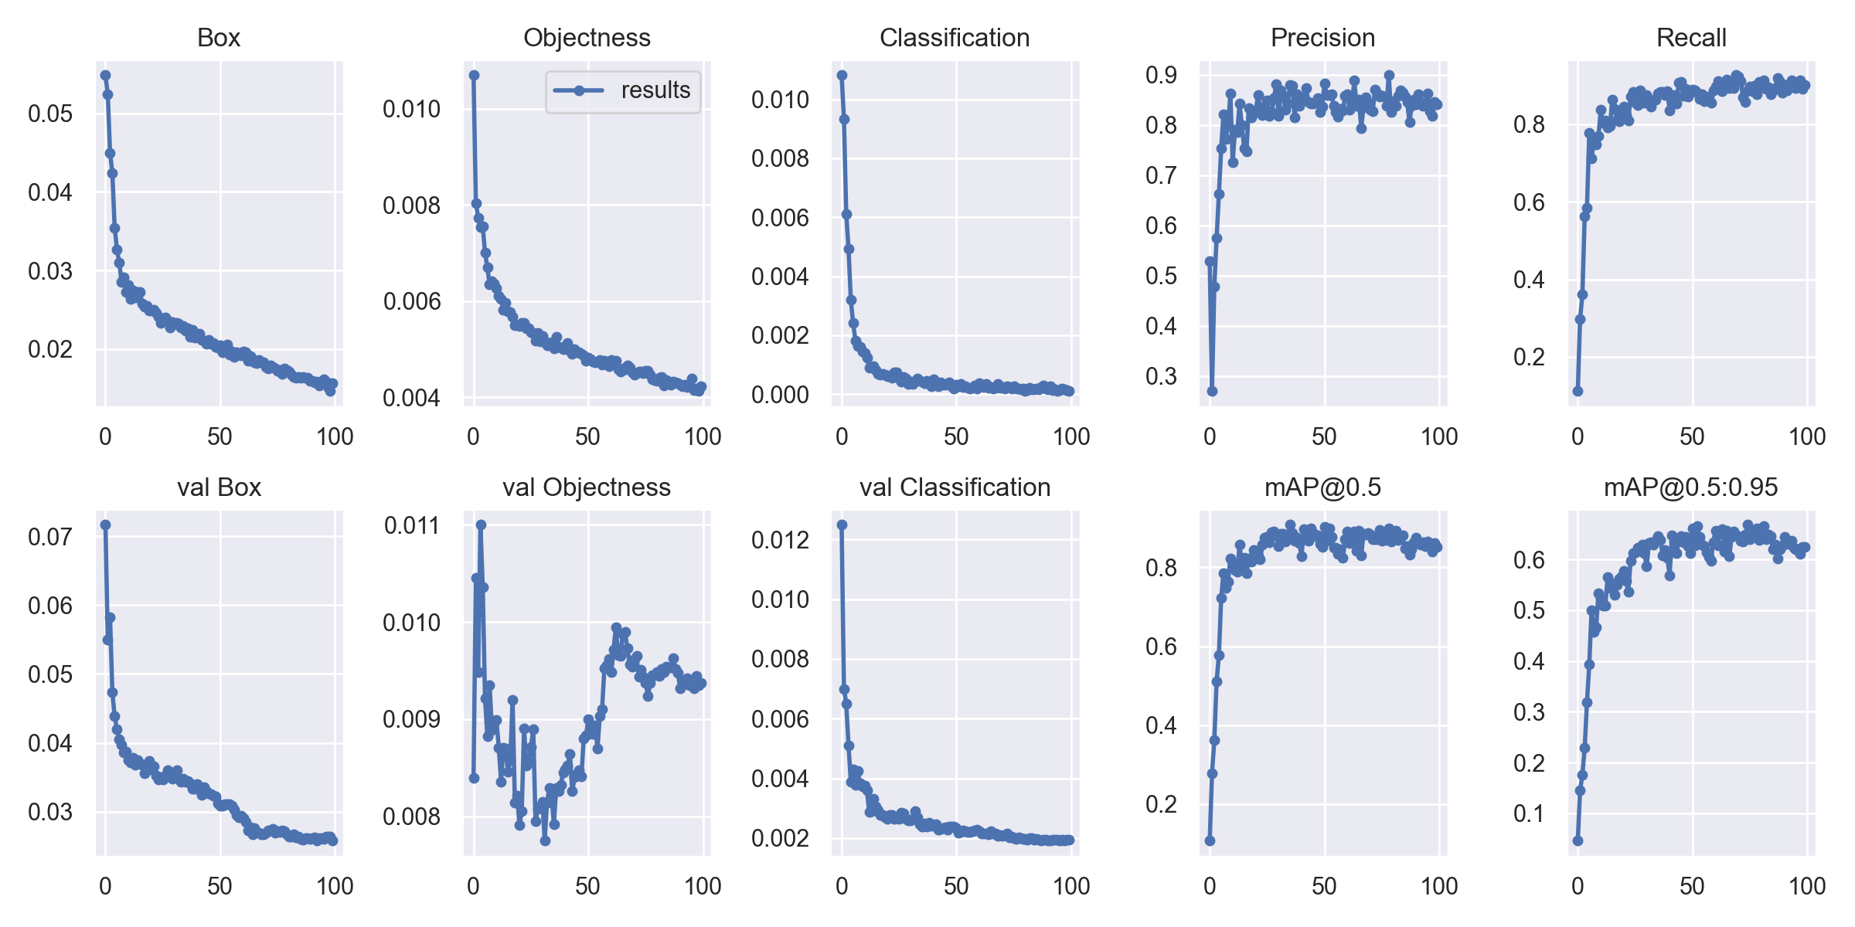
Yolo V7 and V5 Comparison

Slide 15
Object Blurring
Object blurring was implemented on the trained model.
The detected portion of the image was blurred in the object blurring section.

Slide 16

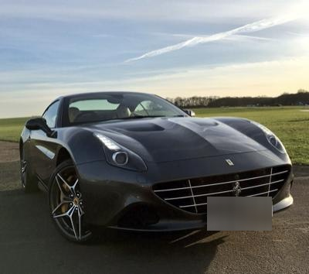
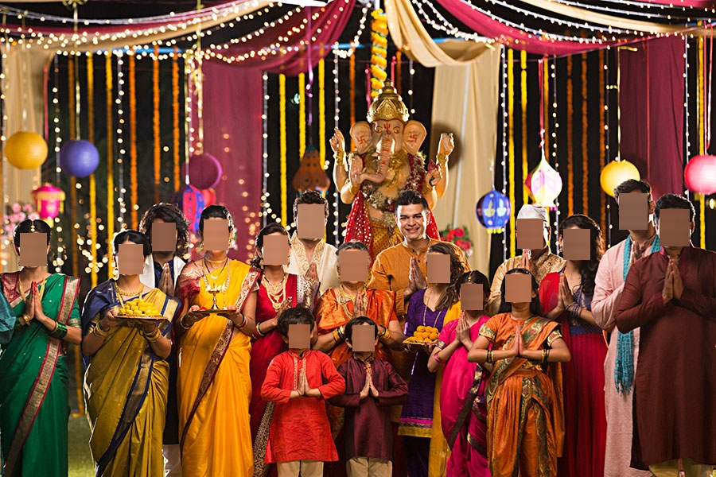
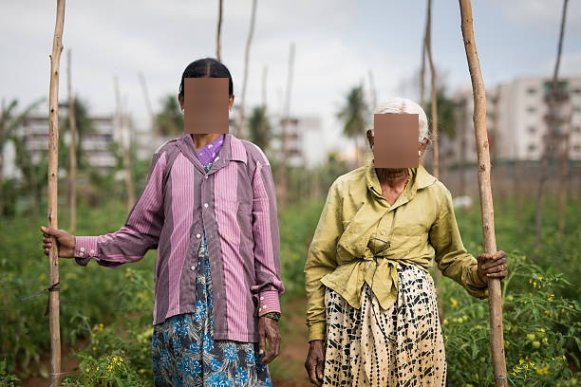
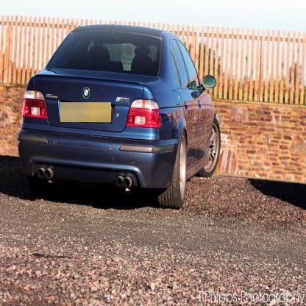
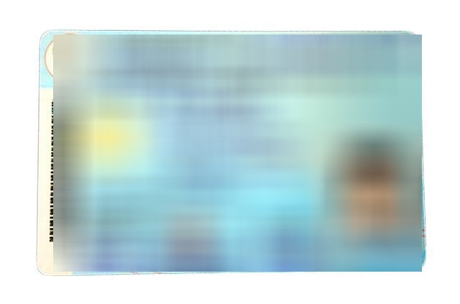
Object Blurring Results
Video 1
Video 2
Video 3

Slide 17
Limitations & Tuning
No ML Model Is Accurate
Limitations in collecting and Processing Data.
In order to boost model performance the following methods can be used:
Adding more images of low performing classes to your training set
Training for Longer period.
Changing Architecture.

Slide 18
Application Kivy Language
Kivy allows construction of widget tree
It separates logical and GUI programming
Parse by python interpreter
Loaded in python

Slide 19
Live Demonstration

Slide 20
Timeline
11 Oct-02 Nov
16 Nov- 02 Dec
09 Dec- 18 Dec
Research
Data
Collection
Building
ML Code
Implementation
of Dataset in Code
Training,
Testing & Validation
Results and Demonstration
03 Nov- 15 Nov
03 Dec- 09 Dec
19 Dec - 21 Dec

Slide 21
References
https://github.com/tensorflow/models/blob/master/research/object_detection/g3doc/tf2_detection_zoo.md
https://bisa.tech/insights-and-research/58-gdpr-data-subject-rights.html
https://www.europarl.europa.eu/RegData/etudes/STUD/2020/641530/EPRS_STU(2020)641530_EN.pdf
https://allaboutberlin.com/guides/photography-laws-germany#how-do-i-get-permission
https://towardsai.net/p/computer-vision/yolo-v5%E2%80%8A-%E2%80%8Aexplained-and-demystified
https://blog.roboflow.com/yolov7-breakdown/
https://github.com/WongKinYiu/yolov7
https://blog.paperspace.com/yolov7/

